Slide 1
EE 475 TERM PROJECT PRESENTATION
Gender and Age Estimation Based on Facial Features
Ege sarıça & hasan emre kayır

Slide 2
The Project ın a nutshell
The purpose of this project is to make an image processing system that can accurately estimate the gender and the age of a person by using data taken from their facial features. This system can be a great use in multiple applications, especially in today’s world.

Slide 3
Our estımated roadmap
1) Data Collection: Using Labeled Faces in the Wild (LFW) dataset, we can reach over 13000 images of faces focusing on age and gender classification.
2) Face Detection: vision.CascadeObjectDetector function* enables us to detect face:
img = imread('image.jpg'); FaceDetect = vision.CascadeObjectDetector; FaceDetect.MergeThreshold = 7 ;
BB = step(FaceDetect, img); figure(2); imshow(img);
for i = 1 : size(BB,1)
rectangle('Position', BB(i,:), 'LineWidth', 2, 'LineStyle', '-', 'EdgeColor', 'r');
end
https://www.mathworks.com/matlabcentral/answers/487886-face-detection-of-multiple-faces-inside-one-image

Slide 4

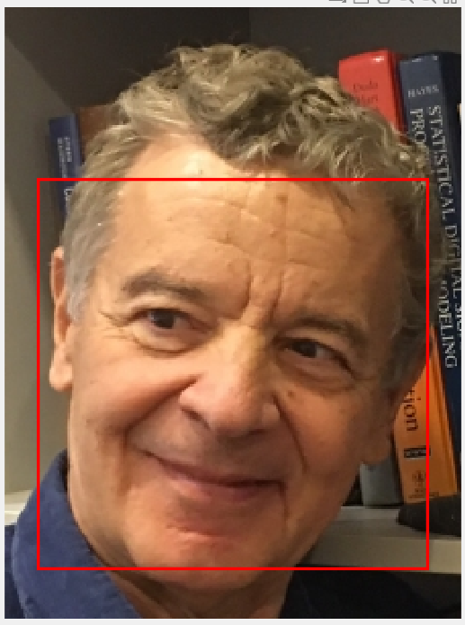
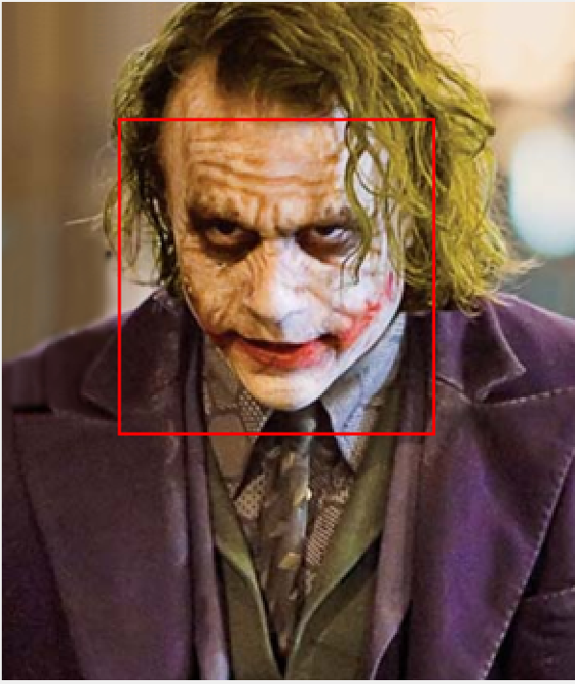
vision.CascadeObjectDetector function has worked even for an image with heavy make-up

Slide 5
Our estımated roadmap
3) Gender Classification: A classification algorithm to determine the gender of each face in the dataset. Support Vector Machines (SVM)* or Convolutional Neural Networks (CNN).
4) Age Estimation: A regression algorithm to estimate the age of each face in the dataset. Linear regression, decision trees, or deep learning models like the ResNet**.
*https://faculty.ucmerced.edu/mhyang/papers/fg2000-paper1.pdf1
**https://www.kaggle.com/code/amanabdullayev/age-prediction-from-photo-using-cnn-resnet50

Slide 6
Our estımated roadmap
5) Evaluation and Application: Using the large dataset we get, we will compare the results from the algorithms and the actual data. We will evaluate the results from the algorithms according to their accuracy of prediction and finalize our program for the best accuracy we can reach.

